Slide 1
CMP5329 Cyber Security
Access Control, Firewalls, and VPNs
PhD. Ngoc-Tu Nguyen
tunn@uit.edu.vn

Slide 2
Security goals
Goals
Cipher systems
- Symmetric (DES, AES)
- Asymmetric (RSA, ECC, CRYSTALS-KYBER)
Confidentiality
Privacy
Integrity
Hash functions
Message authentication code (MAC)
Digital signature (digital certificate)
Authentication
Non-repudiation (Accountability)
Access control
DAC, MAC, RBAC, ABAC, PBAC
Availability

Slide 3
Outline
Access control (DAC, MAC, RBAC, ABAC, PBAC)
Firewalls and network access control (NAC)
Secure connection with VPN

Slide 4
DAC, MAC, RBAC, ABAC and PBAC
Model | Strengths | Use Cases
DAC | User-controlled, flexible, easy to implement | Small businesses, personal environments
MAC | Centralized, secure, non-bypassable | Government, high-security applications
RBAC | Scalable, role-driven | Organizations with structured roles
ABAC | Dynamic, context-aware, fine-grained control | Complex and flexible environments
PBAC | Centralized, rule-driven, compliance-friendly | Zero-trust, regulated industries
Notes:
Cipher=a secret system of writing;

Slide 5
DAC, MAC, RBAC, ABAC and PBAC
Discretionary Access Control (DAC)
DAC is a flexible model where the owner of a resource (file, directory) decides who can access it and how.
Permissions are applied based on the user or group associated with the resource.
Ubuntu case:
02_DAC_Presentation_Guide.md
Notes:
Cipher=a secret system of writing;

Slide 6
DAC, MAC, RBAC, ABAC and PBAC
2. Mandatory Access Control (MAC)
Definition: A security model where access control policies are centrally defined and enforced.
Key Feature: Users and programs cannot override these policies.
Use Case: Enforces stricter control for sensitive systems.
Ubuntu case:
AppArmor: File access, Network access, Execution permissions
SELinux: Programs and system processes
☞ 03_MAC_AppArmor_Guide.md;
☞ 04_MAC_SELinux_Guide.md
Notes:
Cipher=a secret system of writing;

Slide 7
DAC, MAC, RBAC, ABAC and PBAC
3. Role-Based Access Control (RBAC)
Definition: A security model where permissions are assigned to roles rather than individual users.
Key Feature: Users inherit permissions based on their roles.
Use Case: Simplifies permission management in large organizations.
Window Ubuntu cases: Group policie
03_MAC_AppArmor_Guide.md; 04_MAC_SELinux_Guide.md
Notes:
Cipher=a secret system of writing;

Slide 8
DAC, MAC, RBAC, ABAC and PBAC
Feature | Windows | Ubuntu/Linux
Group Management | Local Groups and Active Directory | User Groups
Permission Scope | File, folder, registry, printers | Files, directories, processes
Role Definition | Centralized in AD or Local Policy | Customizable using groups
Ease of Management | GUI tools like Group Policy (gpedit.msc) | Command-line tools like usermod
Notes:
Cipher=a secret system of writing;

Slide 9
DAC, MAC, RBAC, ABAC and PBAC
4. Attribute-Based Access Control (ABAC)
Definition:
A security model that grants or denies access based on attributes (characteristics) of:
Users (e.g., role, department, clearance level)
Resources (e.g., file type, sensitivity)
Environment (e.g., time, location, device)
Notes:
Cipher=a secret system of writing;

Slide 10
DAC, MAC, RBAC, ABAC and PBAC
4. Attribute-Based Access Control (ABAC)
Key Features:
Fine-Grained Control: Policies are more flexible and precise than role-based access control.
Context-Aware: Considers multiple attributes to enforce policies.
Dynamic: Can adapt to real-time changes in attributes.
Notes:
Cipher=a secret system of writing;

Slide 11
DAC, MAC, RBAC, ABAC and PBAC
4. Attribute-Based Access Control (ABAC)
Example Use Case:
A finance document is accessible only if:
The user is in the Finance Department.
The access request is during business hours.
The request originates from a corporate network.
☞ 06_ABAC_OPA_Guide.md
Notes:
Cipher=a secret system of writing;

Slide 12
DAC, MAC, RBAC, ABAC and PBAC
5. Policy-Based Access Control (PBAC)
Definition:
A form of access control that uses an authorization policy that is flexible in the types of evaluated parameters (e.g., identity, role, clearance, operational need, risk, heuristics) (CNSSI 4009-2022).
A security model where access decisions are made based on centralized, pre-defined policies.
Policies dictate access control rules independently of roles or attributes.
Notes:
Cipher=a secret system of writing;

Slide 13
DAC, MAC, RBAC, ABAC and PBAC
5. Policy-Based Access Control (PBAC)
Key Features:
Centralized Policies: Manage access rules in a unified location.
Dynamic Control: Policies can be updated to adapt to new requirements.
Fine-Grained: Combines aspects of MAC and RBAC, ABAC for enforcing strict environment-level access control policies.
 Ref: https://nvlpubs.nist.gov/nistpubs/Legacy/SP/nistspecialpublication800-95.pdf (p.3-16)
Notes:
Cipher=a secret system of writing;

Slide 14
DAC, MAC, RBAC, ABAC and PBAC
Example Use Case:
Allow access to a database:
If the user role is "Admin."
And the request comes from a secure network (LAN or VPN).
And the time is during business hours.
Notes:
Cipher=a secret system of writing;

Slide 15
DAC, MAC, RBAC, ABAC and PBAC
Implementation in Ubuntu:
Use tools like iptables and firewalld for network-level PBAC.
Combine with policy engines like Open Policy Agent (OPA) for application-level PBAC.
Notes:
Cipher=a secret system of writing;

Slide 16
DAC, MAC, RBAC, ABAC and PBAC
Example Use Case:
Allow access to a database:
If the user role is "Admin."
And the request comes from a secure network (LAN or VPN).
And the time is during business hours.
Notes:
Cipher=a secret system of writing;

Slide 17
Firewalls and network access control (NAC)
Definition:
A firewall is a network security device or software that monitors and controls incoming and outgoing network traffic.
Access is permitted or denied based on predefined security rules (policies).
Notes:
Cipher=a secret system of writing;

Slide 18
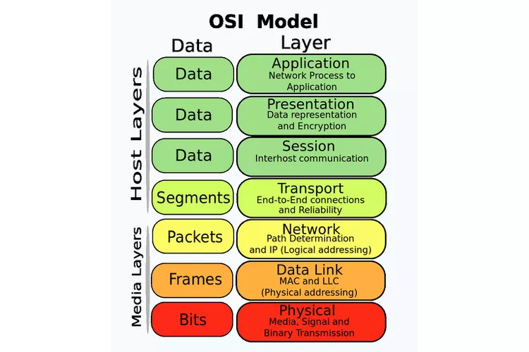
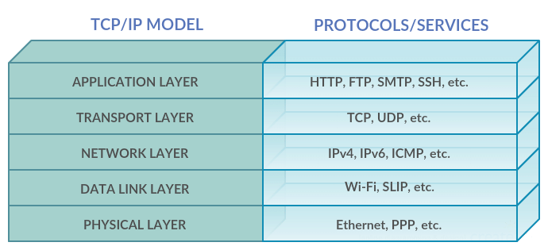
Motivations

Slide 19
Firewalls and network access control (NAC)
Types of Firewalls:
Network Firewalls:
Operate at the network level.
Inspect packets using network protocols (like TCP/IP).
Application Firewalls:
Monitor traffic for specific applications or services.
Host-Based Firewalls:
Installed on individual devices.
Protect a specific host.
Notes:
Cipher=a secret system of writing;

Slide 20
Firewalls and network access control (NAC)
Types of Firewalls:
1. Network Firewalls
Operate at the network level to monitor and control traffic between multiple devices or networks.
Used in routers, gateways, or as standalone devices.
Implement packet filtering, NAT, and VPN routing.
Examples: iptables, firewalld, pfSense, Cisco ASA (Adaptive Security Appliance), .
Notes:
Cipher=a secret system of writing;

Slide 21
Firewalls and network access control (NAC)
Feature | iptables | ufw | firewalld | pfSense | Cisco ASA
Type | Host-based, Network | Host-based | Host-based, Network | Network-based | Enterprise Network
Ease of Use | Advanced CLI | Beginner-friendly CLI | Intermediate CLI | Web GUI-based | CLI + GUI
Dynamic Rules | No | No | Yes | Yes | Yes
Stateful Inspection | Yes | Yes | Yes | Yes | Yes
Application Layer | No | No | Limited | Limited (Plugins) | Yes
Advanced Features | Packet filtering | Simplified rules | Zone-based configuration | IDS/IPS | VPN, Threat Detection
Scalability | Small to medium setups | Small to medium setups | Medium to large setups | Medium to large setups | Large enterprises
Use Cases | Custom Linux servers | Personal Linux servers | Flexible zone management | SMB and home networks | Enterprise networks
Best For | Advanced configurations | Simplified setups | Dynamic environments | SMBs or advanced users | Enterprise edge security
Notes:
Cipher=a secret system of writing;

Slide 22
Firewalls and network access control (NAC)
2. Application Firewalls
Focus specifically on filtering traffic for individual applications or services.
Operate at the application layer (Layer 7 in OSI).
Can detect and block malicious application behavior, such as SQL injections or XSS attacks.
Examples: ModSecurity, Nginx WAF (Web Application Firewall).
Notes:
Cipher=a secret system of writing;

Slide 23
Firewalls and network access control (NAC)
Feature | ModSecurity | Nginx WAF | NAXSI | OpenResty WAF
Ease of Use | Moderate | Easy | Easy | Advanced
Focus | Comprehensive (OWASP rules) | Load balancing + WAF | XSS and SQLi protection | Custom, dynamic rules
Performance | Moderate | High | High | High
Best For | Comprehensive protection | High-performance sites | Lightweight use cases | Advanced dynamic rules
Notes:
Cipher=a secret system of writing;

Slide 24
Firewalls and network access control (NAC)
3. Host-Based Firewalls
Installed directly on individual devices or servers.
Protect a single machine by filtering traffic in and out of that host.
Provide process-level control and application-specific rules.
Examples: Windows defender firewall, ufw, iptables (configured for a single machine).
Notes:
Cipher=a secret system of writing;

Slide 25
Firewalls and network access control (NAC)
Network Access Control (NAC)
Definition:
NAC ensures that only authorized users and devices can access a network.
Uses authentication, authorization, and policy enforcement.
Notes:
Cipher=a secret system of writing;

Slide 26
Firewalls and network access control (NAC)
Network Access Control (NAC)
Key Features of NAC:
Pre-Admission Control:
Devices must meet certain criteria before joining the network (e.g., up-to-date antivirus).
Post-Admission Control:
Continuously monitors and enforces policies for connected devices.
Notes:
Cipher=a secret system of writing;

Slide 27
VPNs in Network Access Control (NAC)
What is a VPN?
A Virtual Private Network (VPN) securely connects remote users or devices to a private network over the internet.
Ensures confidentiality, integrity, and authentication of network traffic.
Notes:
Cipher=a secret system of writing;

Slide 28
VPNs in Network Access Control (NAC)
Why Use VPNs in NAC?
Provides secure access to corporate resources.
Enforces access control policies for remote devices.
Ensures traffic is encrypted and monitored.
Notes:
Cipher=a secret system of writing;

Slide 29
VPNs in Network Access Control (NAC)
Key Features of VPNs in NAC:
Authentication: Verify user/device identity before granting access.
Encryption: Encrypt traffic between endpoints.
Access Control: Restrict access based on roles, locations, or devices.
Notes:
Cipher=a secret system of writing;

Slide 30
VPNs in Network Access Control (NAC)
1. OpenVPN
Open-source VPN solution.
Highly configurable with strong encryption (TLS, AES-256).
Supports site-to-site and remote access VPNs.
2. WireGuard
Lightweight and high-performance VPN.
Uses modern encryption standards like ChaCha20.
Easy to configure and integrate into NAC systems.
Notes:
Cipher=a secret system of writing;

Slide 31
VPNs in Network Access Control (NAC)
3. IPsec (Internet Protocol Security)
Commonly used for site-to-site VPNs.
Encrypts IP traffic with high security.
Supported natively in most operating systems.
Notes:
Cipher=a secret system of writing;

Slide 32
VPNs in Network Access Control (NAC)
4. PPTP and L2TP
Older protocols with limited security.
L2TP is often paired with IPsec for stronger encryption.
Notes:
Cipher=a secret system of writing;

